Slide 1

BITS, PILANI – K. K. BIRLA GOA CAMPUS
Operating Systems
by
Mrs. Shubhangi Gawali
Dept. of CS and IS

Slide 2
OPERATING SYSTEMS
LECTURE 11: CPU SCHEDULING

Slide 3
Basic Concepts
Maximum CPU utilization obtained with multiprogramming.
CPU–I/O Burst Cycle – Process execution consists of a cycle of CPU execution and I/O wait.
CPU burst distribution
Burst/Service time = total processor time needed in one CPU-I/O burst cycle.

Slide 4

Alternating Sequence of CPU And I/O Bursts

Slide 5

Processes
Processes can be described as either:
  CPU-bound process – spends more time doing computations; few very long CPU bursts
  I/O-bound process – spends more time doing I/O than computations, many short CPU bursts
Notes:
Jobs with long CPU burst time are CPU-bound jobs and are also referred to as “long jobs”.
Jobs with short CPU burst time are IO-bound jobs and are also referred to as “short jobs”.
CPU-bound processes have longer CPU bursts than I/O-bound processes.

Slide 6


Slide 7
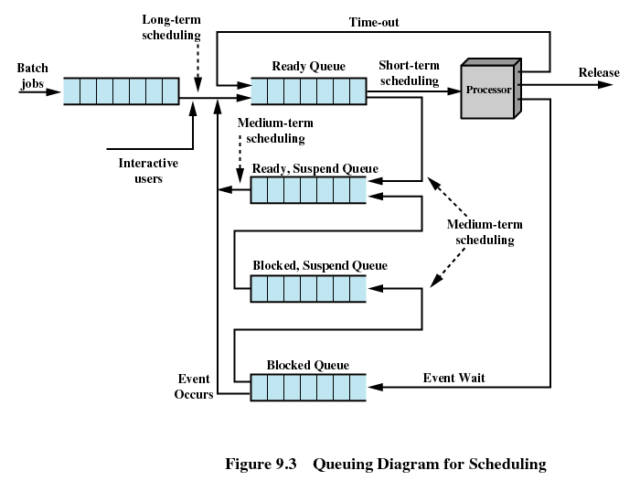

Slide 8
Schedulers
Long-term scheduler (or job scheduler)
  Selects which processes should be brought into the ready queue
  Controls the degree of multiprogramming
  More processes, smaller percentage of time each process is executed
Short-term scheduler (or CPU scheduler)
  Selects which process should be executed next and allocates
  Known as the dispatcher & Executes most frequently
  Invoked when an event occurs
    Clock interrupts, I/O interrupts, OS calls, Signals, CPU

Slide 9
Addition of Medium Term Scheduling
Part of the swapping function
Based on the need to manage the degree of multiprogramming

Slide 10
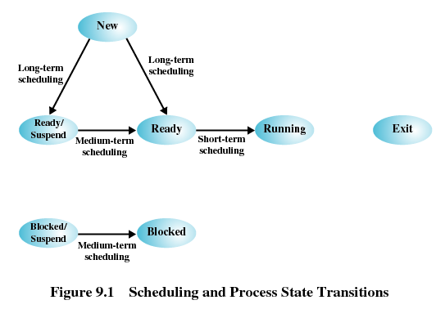

Slide 11
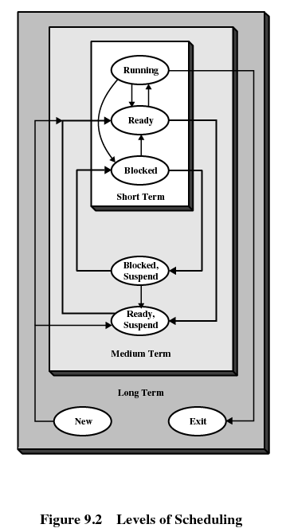

Slide 12
Schedulers (Cont)
Short-term scheduler is invoked very frequently (milliseconds) ⇒ (must be fast)
  CPU scheduler: selects from among the processes in memory that are ready to execute, and allocates the CPU to one of them
Long-term scheduler is invoked very infrequently (seconds, minutes) ⇒ (may be slow)

Slide 13
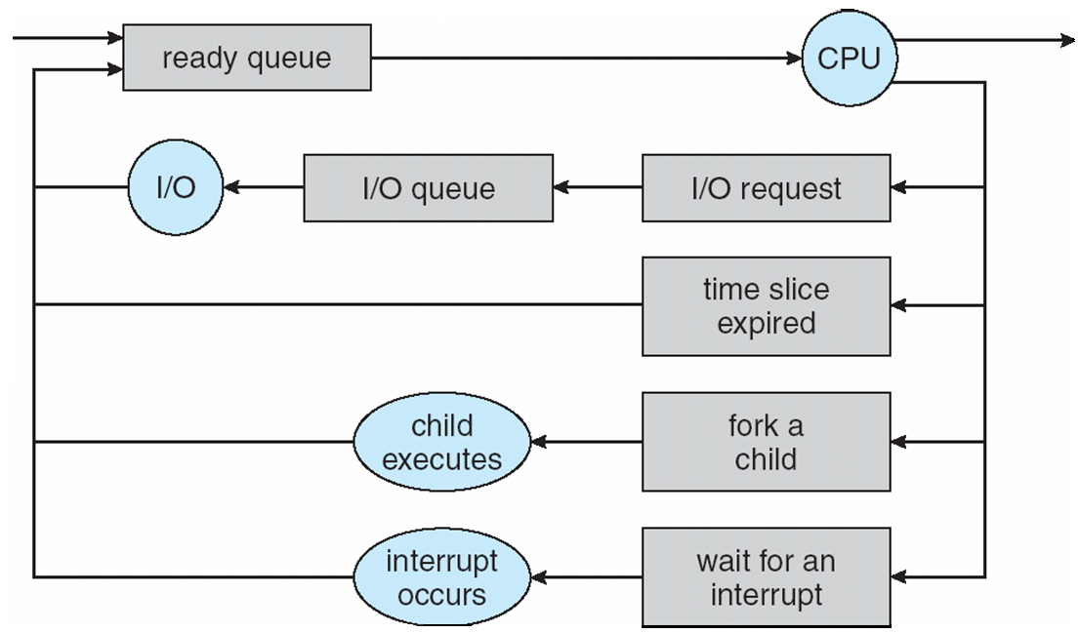
CPU scheduling decisions may take place when a process:
  1. Switches from running to waiting state
  2. Switches from running to ready state
  3. Switches from waiting to ready
  4. Terminates
Scheduling under 1 and 4 is nonpreemptive
All other are preemptive

Slide 14
Characterization of Scheduling Policies
The selection function: determines which process in the ready queue is selected next for execution.
The decision mode: specifies the instants in time at which the selection function is exercised.
  Nonpreemptive:
    Once a process is in the running state, it will continue until it terminates or blocks itself for I/O.
  Preemptive:
    Currently running process may be interrupted and moved to the Ready state by the OS.
    Allows for better service since any one process cannot monopolize the processor for very long.

Slide 15
Dispatcher
Dispatcher module gives control of the CPU to the process selected by the short-term scheduler; this involves:
  switching context
  switching to user mode
  jumping to the proper location in the user program to restart that program
Dispatch latency – time it takes for the dispatcher to stop one process and start another running

Slide 16
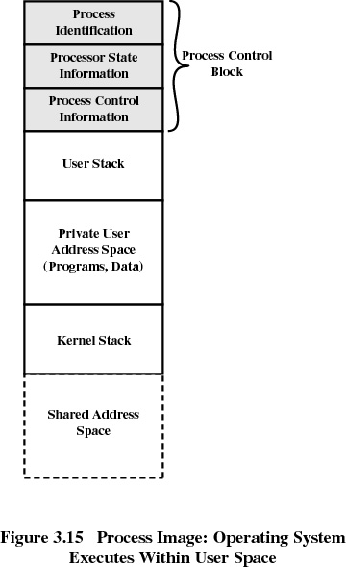

Slide 17
Process Control Block Contains
  Run state and scheduling
  Memory management information
  Hardware state
  Signaling
  Access control
  Input and output
Process id
Parent process id
Child process ids
Process group id(s)
User id
Effective user id
Group id(s)
Effective group id(s)
Account id
Priority level
Elapsed CPU time
Start time
Scheduled start time
Maximum cpu time
Memory allocation

Slide 18
Scheduling Criteria
CPU utilization: amount of time in percentage that a processor is busy.
Throughput: No of processes completed per time unit.
Turnaround time: the interval from time of submission to the time of completion (execution + waiting for resources/processor)
Waiting time: sum of periods spent waiting in the ready queue
Response time: time from submission of a request until the first response is produced.
Deadline: Maximize no of processes meeting their deadlines ( imp for real time systems)

Slide 19
Scheduling Algorithm Optimization Criteria
Max CPU utilization
Max throughput
Min turnaround time
Min waiting time
Min response time

Slide 20
CPU Scheduling Criteria
User-oriented
  Response Time
    Elapsed time between the submission of a request until there is output.
System-oriented
  Effective and efficient utilization of the processor
Performance-related
  Quantitative
  Measurable such as response time and throughput

